Slide 1




Introduction to Web Development
Presentation

Slide 2

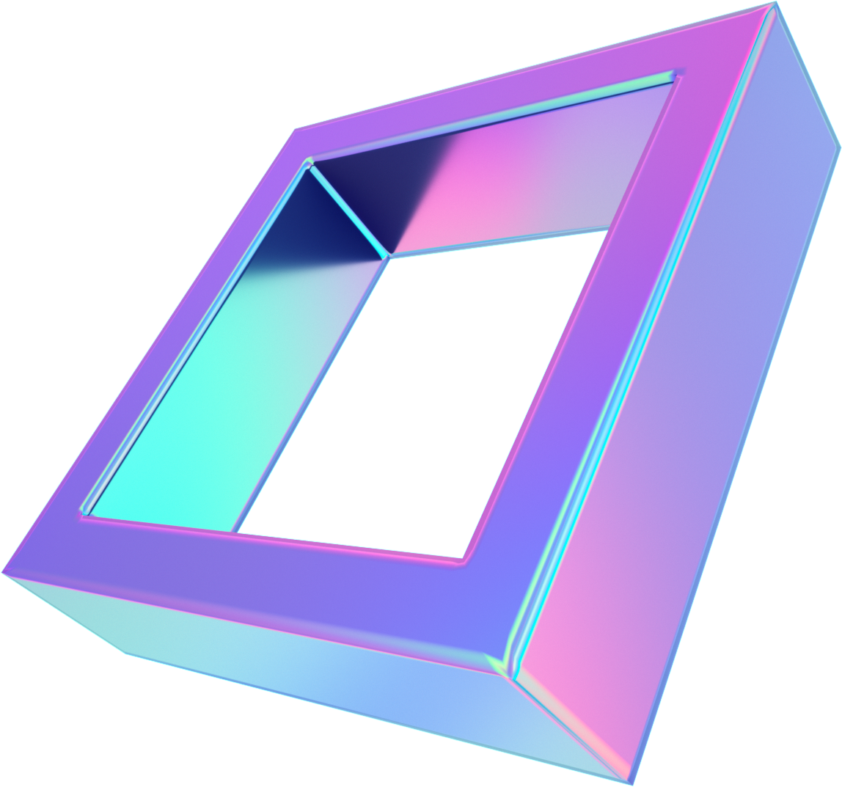
Agenda
What is Web development ?
why is Web development important ?
Front-End vs. Back-End Development
Key Technologies and Tools
Web Development Process
Career Opportunities
Conclusion

Slide 3




Why is Web Development Important?
Front-End
vs.
Back-End Development
What is Web Development?
Web development refers to the process of building and maintaining websites or web applications.
It encompasses various tasks, including web design, content creation, coding, and server management.
In the digital age, the web is a primary medium for communication, commerce, and information.
Web development allows businesses and individuals to establish an online presence.
It enables interactivity, accessibility, and global reach.
Front-End Development:
Focuses on the user interface (UI) and user experience (UX).
Involves HTML, CSS, and JavaScript.
Back-End Development:
Manages server-side operations and data storage.
Involves server-side scripting languages like Python, Ruby, PHP, or Node.js.
Q1
Q2
Q3

Slide 4


Key Technologies
and Tools
Q4
HTML
CSS
Version Control
JavaScript
Code Editors
Back-End Technologies
Web Development Frameworks

Slide 5





Key Technologies and Tools
HTML
CSS
JavaScript
Web Development Frameworks
(Hypertext Markup Language): Used for creating the structure of web pages.
(Cascading Style Sheets): Used for styling and layout.
Adds interactivity and functionality.
e.g., React, Angular, Vue.js.
Back-End Technologies
Code Editors
Version Control
e.g., Node.js, Django, Ruby on Rails.
Visual Studio Code, Sublime Text.
e.g., Git and GitHub.

Slide 6

Key Technologies and Tools
HTML
HTML (Hypertext Markup Language) is a fundamental building block of the internet. It provides a standardized structure for web content, defining elements like headings, paragraphs, lists, links, and media. Web browsers use HTML to render web pages, interpreting the tags and formatting instructions within HTML documents to display text and multimedia content as intended by web developers.
HTML is versatile and essential for creating webpages and applications, allowing developers to organize content, incorporate images, videos, and interactive features. It serves as the backbone for modern web development, working in conjunction with CSS (Cascading Style Sheets) and JavaScript to create dynamic and visually appealing websites and web applications that are accessible across various devices and browsers.

Slide 7
Key Technologies and Tools
CSS
CSS (Cascading Style Sheets) is a crucial web development technology that complements HTML. It defines the presentation and layout of web content, allowing developers to control elements' visual aspects such as colors, fonts, spacing, and responsiveness. CSS enables consistency and aesthetic appeal, separating the content (HTML) from its styling.
With CSS, web designers can create responsive and user-friendly interfaces, adapting to different screen sizes and devices. CSS frameworks like Bootstrap and preprocessors like Sass enhance productivity and maintainability. Additionally, CSS animations and transitions enable engaging user experiences. CSS is vital for achieving design flexibility, ensuring cross-browser compatibility, and making websites visually appealing, making it an essential tool for modern web development.

Slide 8
Key Technologies and Tools
JAVA SCRIPT
JavaScript is a versatile and essential programming language for web development. It enables dynamic and interactive web experiences by allowing developers to manipulate HTML and CSS in real-time. JavaScript is executed in web browsers, empowering the creation of client-side functionality, such as form validation, animations, and interactive user interfaces. Additionally, with Node.js, JavaScript can be used on the server-side, facilitating full-stack development.
JavaScript has a rich ecosystem with numerous libraries and frameworks like React, Angular, and Vue.js, simplifying complex tasks and enhancing productivity. Its broad adoption and constant evolution make it a cornerstone of modern web development, enabling web applications that are responsive, feature-rich, and capable of delivering engaging user experiences.

Slide 9
Key Technologies and Tools
backend languages
Python: Python is a versatile, high-level programming language known for its readability and simplicity. It's used for web development, data analysis, automation, and more.
Ruby: Ruby is a dynamic, object-oriented scripting language. It's favored for its elegant syntax and is often used for web development, notably with the Ruby on Rails framework.
PHP: PHP is a server-side scripting language designed for web development. It's widely used for creating dynamic websites and web applications, with a focus on simplicity and performance.

Slide 10
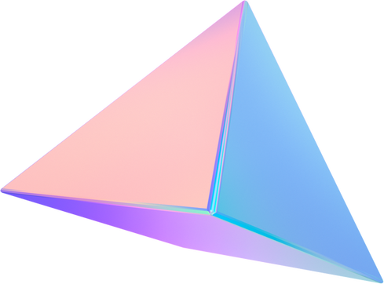


Web Development Process
Q5
Planning : Define project goals, scope, and target audience.
Design : Create wireframes, prototypes, and visual designs.
Development : Write code for front-end and back-end components.
Testing : Debug, test, and ensure compatibility across browsers/devices.
Deployment : Launch the website/application on a server.
Maintenance : Regular updates, bug fixes, and improvements

Slide 11



Q6
Career Opportunities
Web Developer
UI/UX Designer
Digital Marketing
Front-End, Back-End, or Full-Stack.
Focuses on user interface and user experience.
Utilizes web for marketing campaigns.
AND MANY MORE.

Slide 12

Conclusion
Web development is essential in the digital era.
It involves front-end and back-end development, using various technologies and tools.
The web development process includes planning, design, development, testing, deployment, and maintenance.
A wide range of career opportunities exists in the web development field.

Slide 13
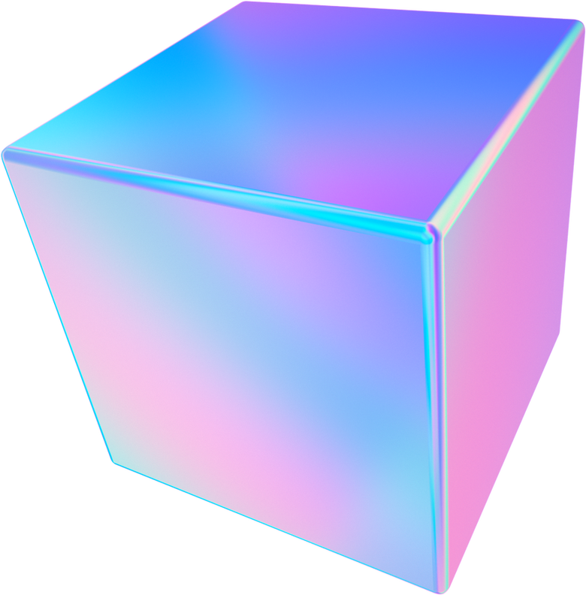
Thank you for your attention!

